Slide 1
TRADEMARK INFRINGEMENT:
McDonald’s Vs McCurry
2K19/CO/319 RITIK SINGH

Slide 2
McDonald's
McDonald's Corporation is the world's largest chain of hamburger fast food restaurants, serving nearly 47 million customers daily. At one time it was the largest global restaurant chain, it has since been surpassed by multi-brand operator Yum! (KFC, Taco Bell and others) and sandwich chain Subway.
Each McDonald's restaurant is operated by a franchisee, an affiliate, or the corporation itself.
McDonald's was established in 1955, California, United States.
McDonald's primarily sells hamburgers, cheeseburgers, chicken products, French fries, breakfast items, soft drinks, milkshakes, and desserts. In response to obesity trends in western nations and in the face of criticism over the healthiness of its products, the company has modified its menu to include such healthier alternatives as salads, wraps and fruit.

Slide 3
McCurry
McCurry is the first Indian Fast Food Outlet in Kuala Lumpur, Malaysia.
The restaurant opened for business in 1999 and is situated in the business district along Jalan Ipoh, Kuala Lumpur.
McCurry stands for "Malaysian Chicken Curry". The outlet is a fast food, self service and open restaurant set-up concept and is of international standard.
McCurry's slogan is : "Home food, away from home, Tasty and so Gooood..."

Slide 4
What is a Trademark?
A trademark is a distinctive sign or indicator used by an individual, business organization, or other legal entity to identify that the products or services to consumers with which the trademark appears originate from a unique source, and to distinguish its products or services from those of other entities.
A trademark is designated by the following symbols:
TM (for an unregistered trademark, that is, a mark used to promote or brand goods)
SM (for an unregistered service mark, that is, a mark used to promote or brand services)
® (for a registered trademark)

Slide 5
What is Trademark Infringement?
Trademark infringement is a violation of the exclusive rights attaching to a trademark without the authorization of the trademark owner or any licensees (provided that such authorization was within the scope of the license).
Infringement may occur when one party, the "infringer", uses a trademark which is identical or confusingly similar to a trademark owned by another party, in relation to products or services which are identical or similar to the products or services which the registration covers.
An owner of a trademark may commence legal proceedings against a party which infringes its registration.

Slide 6
What is Trademark Infringement?
Eight specific elements to measure likelihood of confusion:
Strength of the mark
Relatedness of the products
Similarity of the marks
Evidence of actual confusion
Marketing channels used
Type of goods and the degree of care likely to be exercised by the purchaser
Defendant's intent in selecting the mark
Likelihood of expansion of the product lines

Slide 7
Examples of Trademark Infringement
In Singapore in 2005 in McDonald’s Corporation v. Future Enterprises Pte Ltd.
Heard before the Singapore Court of Appeal, McDonald’s Corporation unsuccessfully opposed to the registration of the marks “MacTea,” “MacChocolate,” and “MacNoodles.”
The Court had found the mark neither visually nor aurally similar, and therefore there was no confusion or deception. It also expressed concern over McDonald’s Corporation having a monopoly over the “Mc” prefix.
2001 case of Yuen Yu Kwan Frank v. McDonald’s Corporation,
where the High Court of Justice, Chancery Division, in England held that a restaurant named “McChina” could carry on business selling Chinese food.
In the 1986 United States case of McDonald’s Corporation v. McBagels Inc, McDonald’s
McDonald’s successfully prevented McBagels from using the word “McBagels” in connection with a bagel bakery and restaurant.

Slide 8
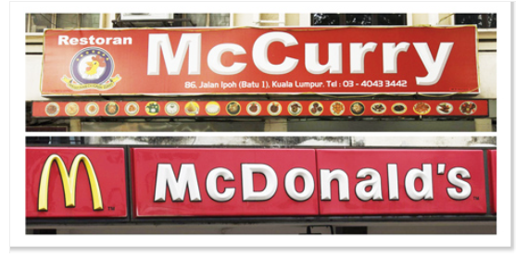

Slide 9
Case History
In 2006, McDonald's won a five year legal battle in Malaysia against a small restaurant named "McCurry", The defendant claimed that McCurry stood for Malaysian Chicken Curry, but a High Court judge ruled that the prefix Mc and the use of colors distinctive of the McDonald's brand could confuse and deceive customers.
In April 2009 however, McCurry won the case again after a retrial. Again in September 2009, McDonald's lost an eight-year trademark battle in a precedent-setting judgment by Malaysia's highest court. The Federal Court ruled that McDonald's cannot appeal against another court's verdict that had allowed McCurry to use 'Mc' in its name.
The ruling by a three-member panel of the Federal Court ends all legal avenues for McDonald's to protect its name from what it said was a trademark infringement. On the basis of unanimous decision, my view is that "McDonald's plea to carry the case forward has no merit, said chief judge Arifin Zakaria.
McDonald's will have to pay RM10,000 to McCurry, a popular eatery in Jalan Ipoh on the edge of Kuala Lumpur's downtown. McDonald's lawyers refused to comment, except to say the company will abide by the judgment.
A three-member Appeal Court panel had ruled in favour of McCurry Restaurant in April this year when it overturned a 2006 high court ruling that had upheld McDonald's contention. Arifin said McDonald's lawyers were unable to point out faults in the Appeal Court judgment, which had said there was no evidence to show that McCurry was passing off McDonald's business as its own.

Slide 10
McDonalds Case
The lawyers of McDonald's restaurant had argued that they have exclusive rights on the prefix and only they can use it on their products and services.
It's argued that the prefix 'Mc' is created as a source of trade identifier and it has secured numerous trademark registrations of the prefix and suffix ‘Mc’.
It was pleaded that McDonald's has created this prefix and has the right to protect it under the law. According to McDonald's, McCurry was infringing their creative rights by using the prefix in their name.
They wanted the court to ban the McCurry from using the prefix.
Mccurry was before Known as Restoran Penang Curry House, it changed its name to 'McCurry' 8 years ago
McCurry had Misrepresented itself as being associated with McDonald's business by using the prefix 'Mc'
The Mccury's can confuse or even deceive customers as they used the prefix Mc together with the yellow and red colors in its signage, as it can be confused with the McDonald's Brand.

Slide 11
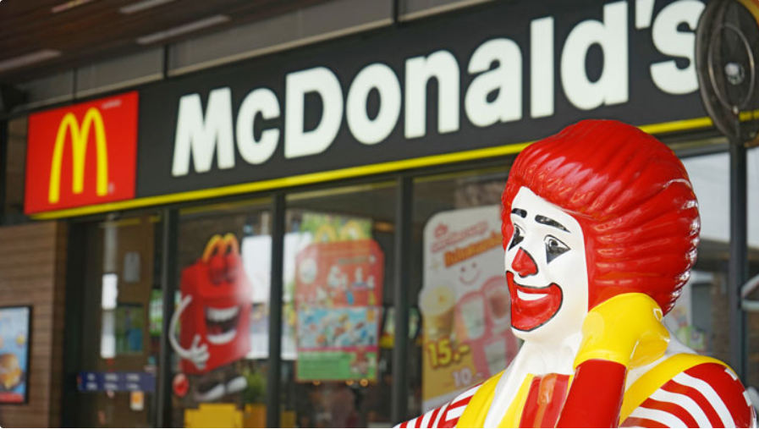

Slide 12
McCurry's Stance!
'Mc' not exclusive to McDonald's - scottish
Different cuisine
McCurry- an abbreviation
No wrong intention
Different market segments
Not aware that McDonald's Corp was the proprietor & operator of the chain of restaurants
Different ambience
Different logo
Items don't carry 'Mc'

Slide 13
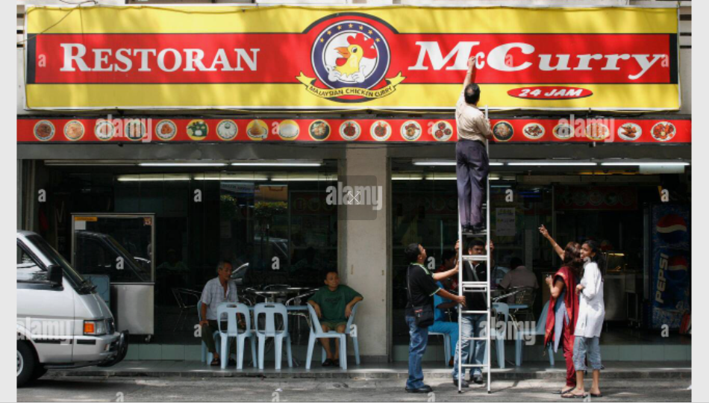

Slide 14
My Take
Based on the Principles of Consumer Behaviour, I suggest that Mccurry was at wrong footing and is infringing on the McD's Trademark and is Deceiving Customers even if a minority by banking on the brand image of McDonald's.
The McCurry Mark is closely similar to McD's.
It May be argued that they have a different customer segment which they cater too.
But, their signage is represented using the prefix 'Mc' in the same manner and color scheme of Mcdonald's mark leads us to the conclusion that it is trying to capitalize on Mcdonald's goodwill and reputation.
If the 'McCurry Mark is represented in a different way and adopted another color scheme,they could have been proven not guilty.

Slide 15
Gracias

